Slide 1

AI-Based Knowledge Graph Builder for Enterprise Intelligence
A scalable, team-wide approach to preparing diverse datasets for Knowledge Graph construction. Milestone 1 Presentation by Group 3

Slide 2

Project Overview
Laying the Foundation: Data Selection, Ingestion, and Cleaning
Project Goal
Milestone 1 Focus
To transform unstructured Reuters financial news into a structured, interconnected Knowledge Graph for automated business insights.
Establishing a robust data foundation through selection, ingestion, and rigorous cleaning.
Our initial efforts concentrate on preparing high-quality data to ensure the reliability and effectiveness of the subsequent graph construction.
1
2
3
Identify Dataset
Data Ingestion
Preprocessing
Selecting a high-density enterprise dataset.
Integrating disparate training and test sets.
Executing text-specific preprocessing for "Graph Readiness."

Slide 3


Data Selection
Dataset Selection: Choosing the Right Foundation
Key Criteria
What Makes a Good Dataset for Knowledge Graphs?
For effective Knowledge Graph construction, selecting a high-quality, relevant dataset is paramount. The chosen corpus should be a foundational element, aligning with the domain
and scope of the desired insights.
High Density: Rich in relevant information and relationships specific to the domain.
Sufficient Volume: Large enough to support robust model training and comprehensive graph population.
Relevant Temporal Scope: Data spanning a suitable time period to capture meaningful historical or current trends.
Rich Entity Categories: Diverse and well-defined categories for organizations, people, places, topics, or other domain-specific entities.
Identifiable Key Entities: The presence of prominent and interconnected entities that form central "hubs" within the graph.
Pre-labeled Data: Essential for validating extraction models and providing ground truth for performance benchmarks.
Importance of Selection
Datasets with well-defined, pre-labeled entities are critical for training and validating extraction models, ensuring the accuracy and reliability of the resulting Knowledge Graph.

Slide 4




Data Management
Data Ingestion: Consolidating Multiple Data Sources
The challenge often involves consolidating overlapping datasets from various contributors or sources into a single, cohesive, and clean master dataset for analysis or knowledge graph construction.
Identify Primary Source
Select a foundational dataset as the primary source, ensuring comprehensive coverage and alignment with project goals when multiple overlapping sources exist.
Integrate Datasets
Consolidate chosen datasets into a unified structure, often leveraging tools like Python/Pandas for efficient data merging and integration into a `master_df`.
Perform Deduplication
Systematically identify and remove redundant or duplicate entries based on unique identifiers to prevent data skewing and ensure data integrity.

Slide 5


Preprocessing Phase
Data Cleaning & Preprocessing: Refining Text for AI Consumption
Noise Removal
Implement techniques like regex patterns to remove irrelevant text, special characters, or formatting artifacts that don't contribute to data meaning.
Missing Value Strategy
Define strategies to handle incomplete or null data, such as removal, imputation, or flagging, to ensure data quality and integrity.
Entity List Parsing
Parse structured or semi-structured data points (e.g., tags, categories, nested objects) into usable formats for subsequent analysis or graph construction.
Normalization
Apply standardization rules, including uniform casing, trim whitespace, and alias resolution, to ensure consistent representation of entities and values.

Slide 6
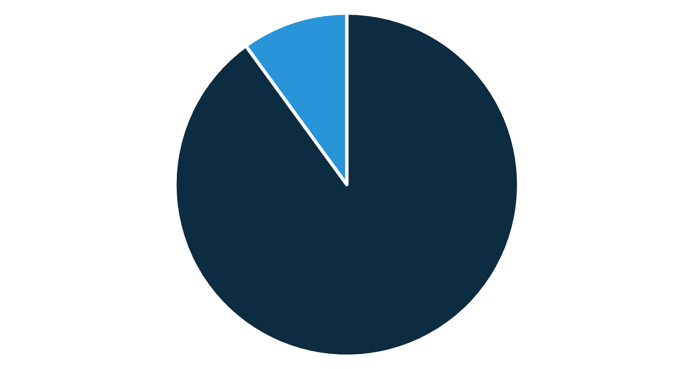
Key Insight
Dataset Readiness Assessment:
Evaluating Graph Potential
A key aspect of dataset readiness involves assessing its
"Graph Potential," which identifies records containing two
or more distinct entity types. This is crucial for constructing an interconnected knowledge graph.
Finding
This assessment helps pinpoint high-value records that
function as primary "relationship mines" within the dataset,
offering rich sources for entity-relationship extraction
essential for graph construction.
Record Composition
Records with Single Entity: These records are
excellent for populating initial node attributes.
Records with Multiple Entities: These form the
core source for extracting graph edges and triplets,
establishing relationships between nodes.
Records with Single Entity
Records with Multiple Entities
Upon completion of this assessment, the dataset is prepared, ensuring compatibility with NLP extraction libraries (e.g., SpaCy) and Graph Databases (e.g., Neo4j), ready for the next phase of graph construction.

